Slide 1
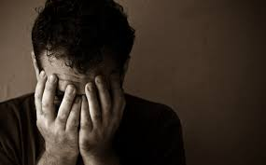

Slide 2
“No one, after al, is supposed to feel guilty. Guilt is not conductive to dignity and self-esteem. Society encourages sin, but it will not tolerate the guilt sin produces.”
John MacArthur

Slide 4
Conduct Disorder
“a persistent pattern of conduct in which the basic rights of others and major age-appropriate societal norms or rule are violated”

Slide 5
Oppositional Defiant Disorder
“a pattern of negativistic, hostile, and defiant behavior”

Slide 6
Histrionic Personality Disorder
“a pervasive pattern of excessive emotionality and attention-seeking”

Slide 7
Antisocial Personality Disorder
“a pattern of rresponsble and antisocial behavior beginning in chldhood or early adolescenc and continuing into adulthood.”

Slide 9
“...the number of people who suffer from such newly identified ‘sickness’ is increasing even faster. The therapy industry is clearly not solving the problem of what Scripture calls sin. Instead it mearly convinces multitudes that they are desperately sick and therefore not really responsble for ther wrong behavior.”
John MacArthur

Slide 11
“Religious leaders once condemned psychoanalysis for its moral neutrality...Now popular religious literature equates illness with sin.”
Wendy Kaminer

Slide 12
“Inner children are always good – innocent and pure – like the most sentimentalized Dickens characters, which means that people are essentially good...Even Ted Bundy had a child within. Evil is merely a mask – a dysfunction.”
Wendy Kaminer

Slide 14
“Where there is no recognition of sin and guilt, when the conscience has been abused into silence, there can be no salvation, no sanctification, and no real emancipation from sin’s ruthless power.”
John MacArthur

